Slide 1
Learned Bloom Filters
Ashwini Ainchwar
30th January, 2023

Slide 2


Traditional Bloom Filters - Review
Given a set S = {x1,x2,x3,…xn} on a universe U, we want to answer membership queries of the form: Does x ∈ S ?
Key
Requirements
Fast (Faster than searching through S)
Small (Smaller than explicit representation).
Bloom Filter
Have we seen it before?
Definitely no
False Negatives
Trade off accuracy for space and time …
Probably, yes
False Positives
Notes:
used for scenarios where false positives are tolerable, and there is incentive on knowing what doesn’t belong to the set
e.g. if a key is not in database, save accessing cold storage, false positives will just lead to some extra accesses

Slide 3
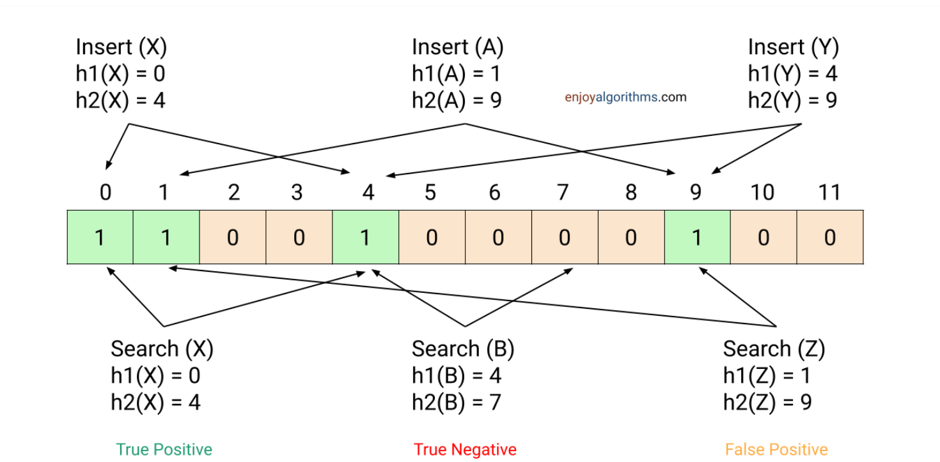
Traditional Bloom Filters - Deeper Look
Bloom Filters contain a group of hash functions and a bit array
n : number of items in set S
m : size of bit array
k : number of hash functions
Assumption: hash functions are perfect and independent
Notes:
so how are bloom filters designed?
k hash functions and bit array of size m
initially everything is 0
mention how keys are inserted
once a bit is set to 1, it is not undone
give lookup examples of colors

Slide 4
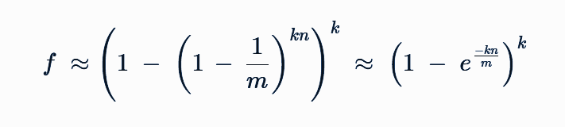
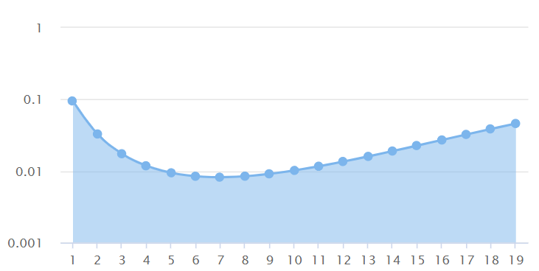
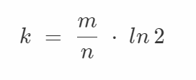
Traditional Bloom Filters - Guarantees
Goal : minimise f
false positive rate for
m/n = 10
f
f : false positive rate
k : number of hash functions
m : size of bit array
n : number of items in set S
Notes:
how to get an approximation for the FPR of bloom filters
to minimise f, set gradient to 0 and find optimal k

Slide 5
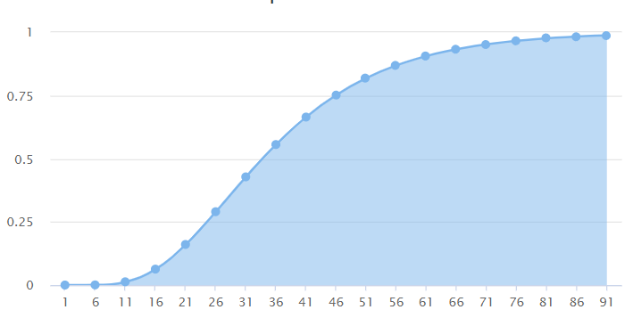
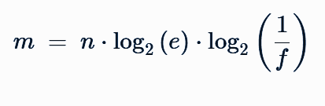
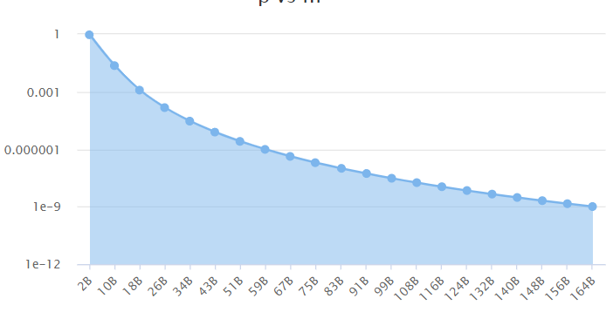
Traditional Bloom Filters - Guarantees
f vs n
plugging in k
f
n
f vs m
m : size of bit array
n : number of items in set S
f : false positive rate
f
e.g. for 1 billion records and FPR of 0.01%
we need Bloom filter ≈ 2.23 GB
m
Notes:
for a fixed size bit array, false positives grow with number of keys
increasing m, size of bit array, reduces false positives significantly

Slide 6
The Case for Learned Index Structures
Learned Bloom Filters

Slide 7
Key Ideas
Indexes are models
Traditional bloom filters make no use of distribution of keys and how keys differ from non-keys
e.g. for all integers between 0 < x < n, our existence index can be f(x) ≡ 1[0 ≤ x < n]
Introduced bloom filters as a classification problem
label keys and non-keys as different classes
Notes:
can make use of nature of data, difference between keys and non keys

Slide 8
Details of classification task
Use historical queries to create a dataset(D) of keys K and non-keys U
D = {(xi, yi = 1)|xi ∈ K} ∪ {(xi, yi = 0)|xi ∈ U}
Train a RNN or CNN with log loss and sigmoid activation
Output will be f(x) which can be thought of as probability that x is a key
Now we need to deal with false positives as well as false negatives
Notes:
assumption we have access to historic data we can create a dataset like

Slide 9
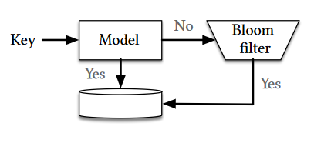
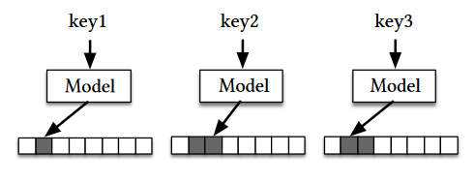


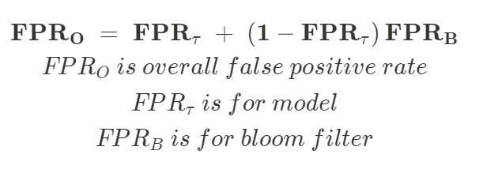
Proposed models
Model
Key
(x)
RNN
f(x)
Bloom filters as a Classification Problem
Bloom filters with Model Hashes
No
x ∈ U
Data
Notes:
we need backup bloom filter because switching to a ML model introduces inaccuracies and consequently false negatives
we use the bloom filter to remove the false negatives
overall FPR

Slide 10
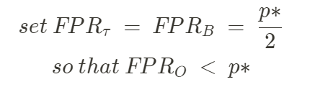


Bloom filters as a Classification Problem Contd.
𝜏 is a hyperparameter tuned as per desired FPR p*
size of overflow bloom filter will scale with the FNR of model
Notes:
how to tune the threshold tau

Slide 11

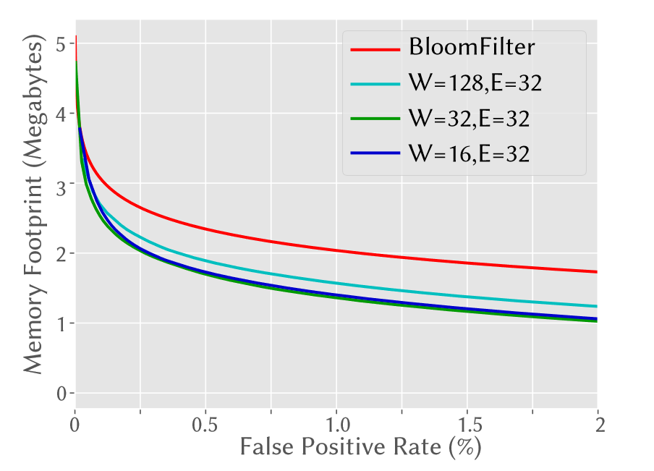
Are bigger models better?
~ 15% size reduction for FPR of 0.1%
~ 36% size reduction for FPR of 1%
Learned Bloom filter improves memory footprint at a wide range of FPRs. (Here W is the RNN width and E is the embedding size for each character.)
Notes:
smaller models can achieve same FPR, no point of using bigger models

Slide 12
Strengths & Weaknesses
👍
small models are also pretty powerful
realistic worst case analysis is missing
space-fpr trade off on bigger datasets
👎
👎
Notes:
worst case
what if data is not linearly separable, and decision boundary is complex, are small models still better
what if the queries in real time differ significantly from the test set
saving are in few MBs at best, do we get similar results on bigger sets
also BF using model-hashes isn’t explained in detail

Slide 13
A Model for Learned Bloom Filters, and Optimizing by Sandwiching

Slide 14
False Positive Probability
🤔
FPR for bloom filters ≠ FPR for learned bloom filters
FPR for bloom filters | FPR for learned bloom filters
number of hash functions (k) bits per key (m/n) nature of hash functions | evaluated empirically on a set no. of false positives / size of set unbounded on test set if distribution of queries differ significantly
e.g. |U| = [0, 10^6], |K| = 1000 out of which 500 elements are in the range [1000, 2000] assuming learned f(x) ~ 0.5 if x ∈ [1000, 2000] and 0 outside, a reasonable 𝝉 might be 0.4
FPR for a Q distributed over [1000, 2000] >> FPR for Q distributed over [0, 10^6]
assuming uniform distribution

Slide 15
Limitations of learned bloom filters
Good choice when the query stream can be modeled as coming from a fixed distribution, which can be sampled during the construction.
Insertions have larger impact on false positive probability
this is because of limited size of overflow bloom filter
Cannot handle deletions
Retraining requires storage and access to original dataset

Slide 16

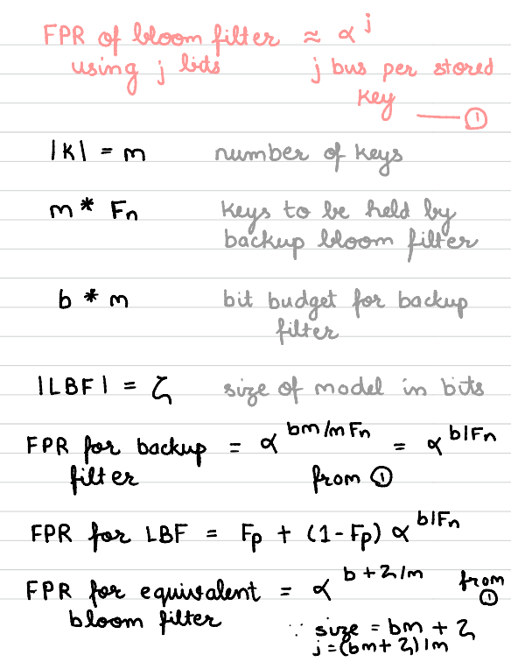
Deeper look into size of LBF
Goal : derive size of model which can perform better than a standard Bloom filter
1️⃣

Slide 17
Deeper look into size of LBF
Goal : derive size of model which can perform better than a standard Bloom filter
2️⃣

Slide 18
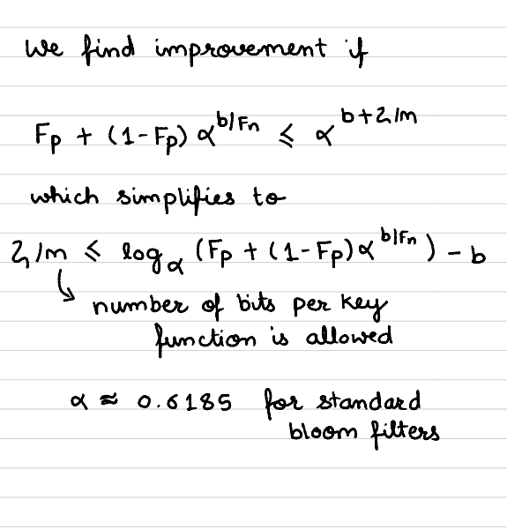
Deeper look into size of LBF
Goal : derive size of model which can perform better than a standard Bloom filter
3️⃣

Slide 19
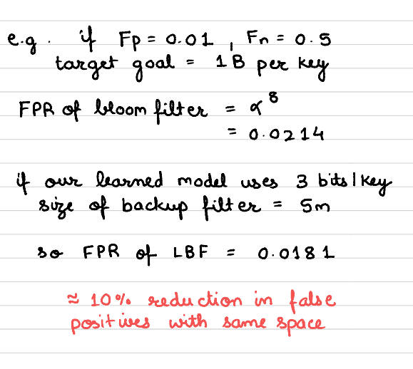
Deeper look into size of LBF
Goal : derive size of model which can perform better than a standard Bloom filter
example

Slide 20
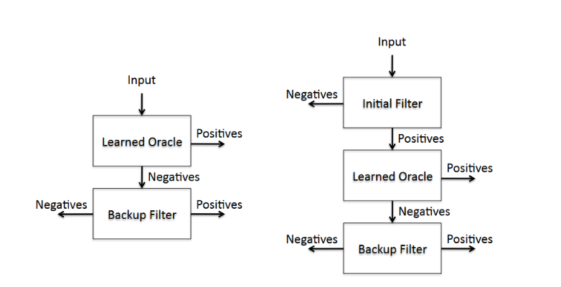
Sandwiched Learned Bloom Filter
initial Bloom filter for the set removes large numbers of potential false positives before reaching the learned.
yields lesser false positives
catches false negatives, can increase false positives
LBF
Sandwiched LBF

Slide 21
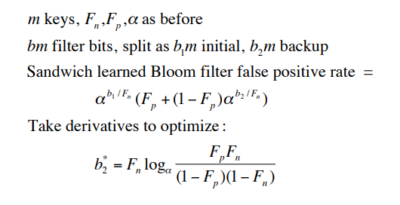

Sandwiched Learned Bloom Filter Analysis
😯
b2 is independent of b!
fixed-sized backup filter
remaining bits go to the initial filter

Slide 22
Sandwiched Learned Bloom Filter Results
for b = 8 bits per key, FPR drops from 0.010045 to 0.005012
for b = 10 bits per key, FPR drops from 0.010066 to 0.001917
2x improvement
10x improvement

Slide 23
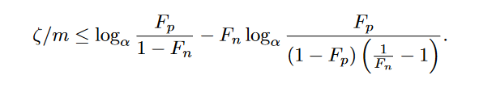
Sandwiched Learned Bloom Filter Model Size
estimating size of model
tells us when can we expect better performance

Slide 24
Sandwiched Learned Bloom Filter Remarks
👍
How does it perform when queries don’t come from same distribution?
performs better, as using an initial bloom filter passes smaller number of keys to the model
👍
Lower FPR using same memory
👎
Increased compute complexity
more hashing and memory accesses for initial filter

Slide 25
Partitioned Learned
Bloom Filter
(PLBF)

Slide 26
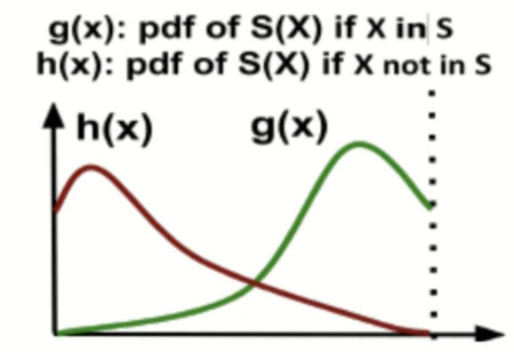
Prediction Observation
learned model predicts likelihood of input being in the set
Key
(x)
Learned Model
f(x)
learned model will assign higher probability to elements in the set compared to elements not in the set

Slide 27
Potential Improvements Over Learned Bloom Filters
Choosing the right threshold
can we do better than using heuristics?
Can we make better use of the predicted probability/ score
if f(x1) >> f(x2), x1 is more likely to be a key
💡
💡
partition the score in more regions
use optimal bloom filters for each region
choose FPR for each region to optimize space/false-positive tradeoff

Slide 28
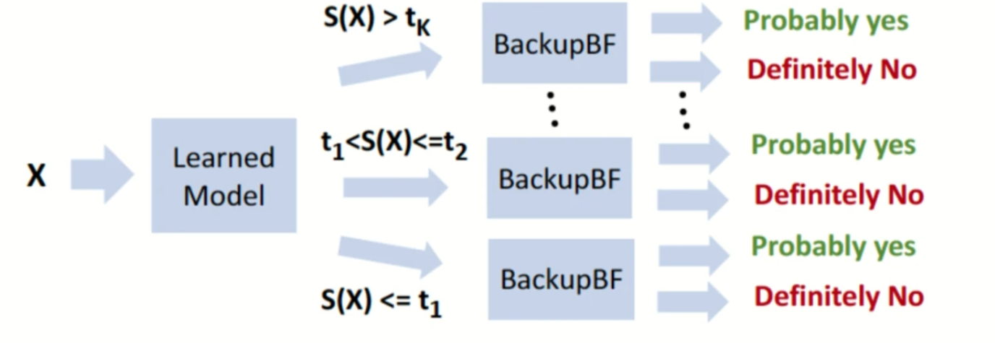
Proposed Design
Parameters
threshold values per region
false positive rate of backup bloom filters

Slide 29

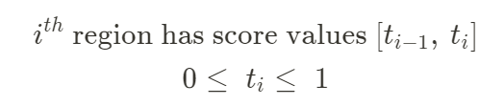
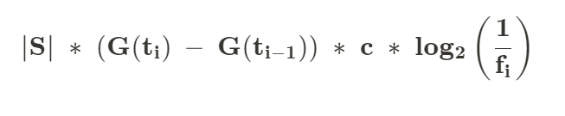
Size of a backup bloom filter
let G(t) be fraction of keys with scores falling below t, H(t) is fraction of non-keys with scores below t
number of keys passed to backup bloom filter i =
if f_{i} is FPR of backup bloom filter i, then it’s size is
Notes:
H(t) to be probability that a non-key query from D has a score less than or equal to t
If non key queries are chosen uniformly at random, non key query distribution would be the same as non key distribution, hence above definition
We assume that H(t) is known in the theoretical analysis below

Slide 30
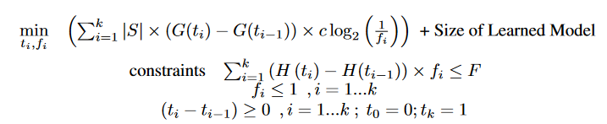
Optimization Formulation - Space savings of PLBF
minimize total size of backup bloom filters while keeping overall FPR below target value
condition to maintain FPR
condition to ensure threshold values are increasing

Slide 31

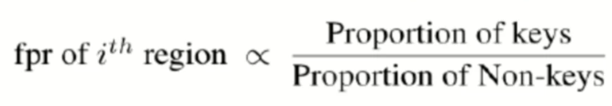
Evaluating parameters - optimal FPR for each region
let G(t) be fraction of keys with scores falling below t
let H(t) be fraction of keys with scores falling below t
Relaxing constraint f_{i} <= 1, and solving previous optimisation problem
Notes:
The numerator G(ti) − G(ti−1) is the fraction of keys in the ith region
the denominator H(ti) − H(ti−1) is the probability of a non-key query being in the ith region.
In intuitive terms, the false positive rate for a region is proportional to the ratio of the key density (fraction of keys) to non-key density (fraction of non-key queries)

Slide 32

Space saved by PLBF
substituting f_{i}, and using
=
similarly setting
space saved by PLBF =

Slide 33
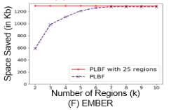
Evaluating parameters - k, thresholds
KL divergence increases with number of partitions k
tune k according to validation set
given k, use known DP algorithms to pick thresholds maximising the KL divergence for each region

Slide 34
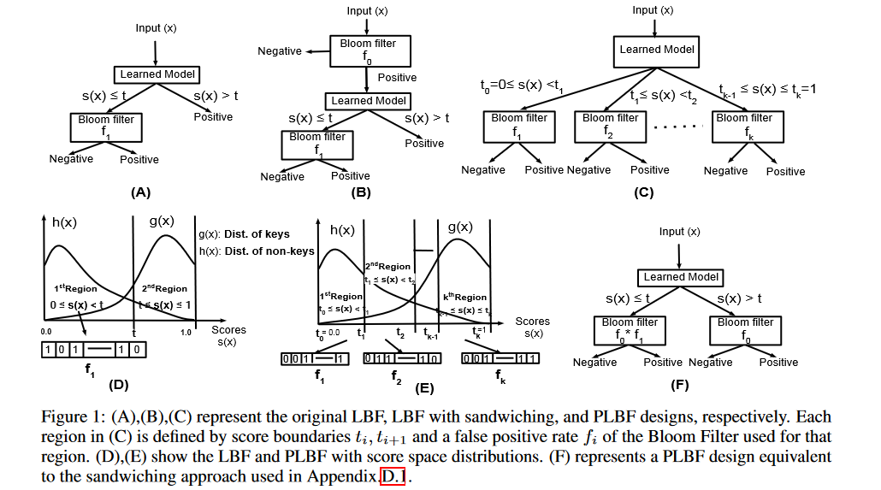
Comparison with other variants

Slide 35
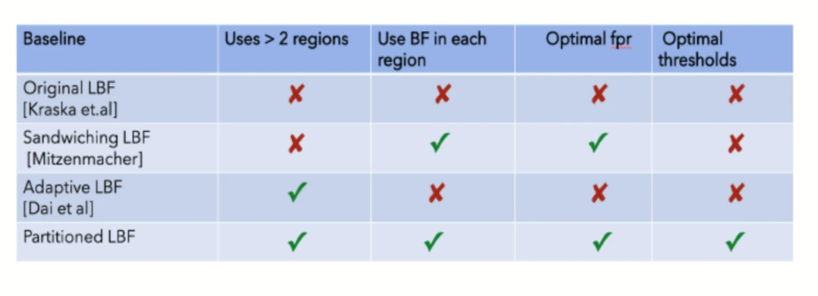
Comparison with other variants

Slide 36
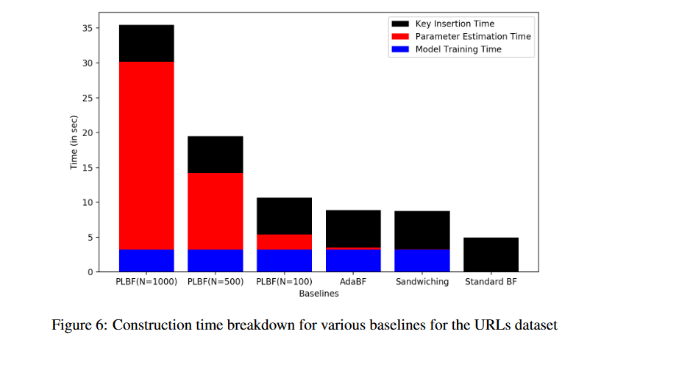
Construction time comparison with other variants
Notes:
N : space discretization parameter, k: thresholds or partitions
We divide the score space F [0, 1] into N consecutive small segments
this provides us a discretization of the score space
larger N more closely approximating the real interval
Given k, we can find a set of k approximately optimal thresholds using dynamic programming, where the solution is approximate due to our discretization of the score space
as other models use heuristics their parameter estimation times are smaller

Slide 37
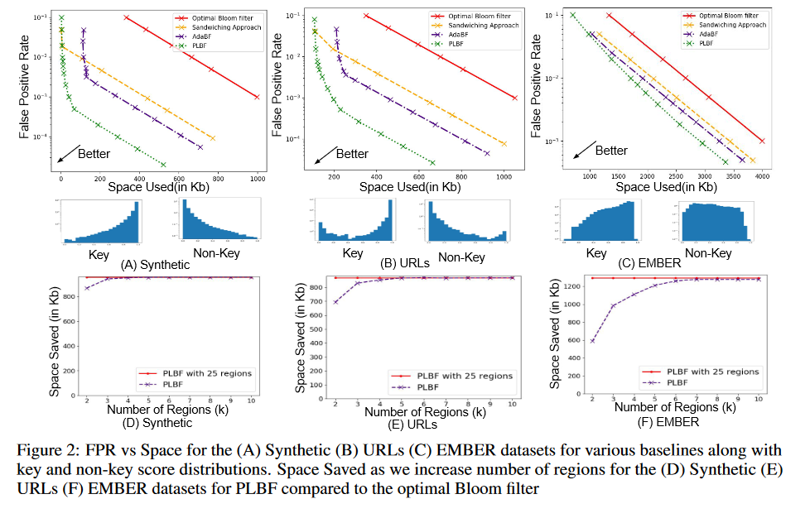
Experiments

Slide 38
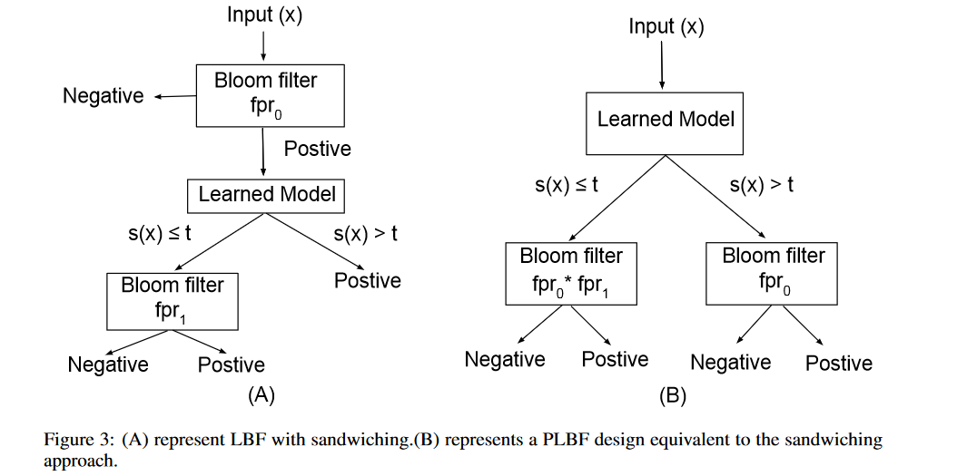
SANDWICHING: A SPECIAL CASE
same FPR
same size
compute time?
Notes:
they can set the fprs of two regions to get equivalent sandwiched bloom filters, i.e. same FPR and space
comparisons on compute time are missing

Slide 39
Strengths & Weaknesses
👍
proposed a more general design while achieving better results
formal analysis of space-fpr trade off for the design and optimisation formulation
reduce efforts for parameter tuning
👍
👍
how does PLBF performance change for inserts
realistic worst case analysis is still missing
Notes:
formulation of the partitioned bloom filter as an optimization problem
partitioned Bloom filters, it seems to be more prone to resizing upon insertions compared with using a single Bloom filter, because of smaller filters
identifying scenarios when query distribution doesn’t come from same distribution D

Slide 40
Repeating Trends
When in doubt, try partitioning.
Mixture of experts
Proxy models
Notes:
try partitioning the data
we have seen bucketing, and here partitioning scores
use multiple models instead of 1 model
RMI
use coarse grained models to get a rough estimate and then tune further

Slide 41
Thank you!

